Slide 1
CS 211 Computer Architecture Lecture 25: Microarchitecture Design - Datapath – Part 1 Processor components – PC, FSM, Muxes, Adder, Subtractor
Ravi Mittal
ravi.mittal@iitgoa.ac.in
Indian Institute of Technology, Goa

Slide 2
Acknowledgements
Book: Harris and Harris, Digital Design and Computer Architecture – RISC-V
Class Presentation, CS61C, Introduction to Assembly Language and RISC-V Instruction Set Architecture, University of Berkeley, Prof Krste Asanović & Randy H. Katz. http://inst.eecs.Berkeley.edu/~cs61c
Lecture slides of Prof Onur Mutlu, ETH Zurich, Spring 2018,
Book: Pratt and Patel, Introduction to Computing Systems: From Bits & Gates to C/C++ & Beyond

Slide 3
RISC-V: So far we have studied
Arithmetic operations: add, sub, addi,
How to bring data from memory to register and vice versa?
lw, sw, lb, sb, lbu
Bit-by-bit logical instructions
and, or, xor
andi, ori, xori
Logical Shift instructions
sll, srl, sra, slli, srli, srai
Generating Constants
Branching Instructions: beq, bne, blt/bltu, bge/bgeu
Jumping instruction: j
Assembly level program for: if, if/else, while, for loops
Function Calls
Basics
Input arguments and Return Value
The Stack
Basics
How functions use a stack
Stack use in non-leaf function calls
Recursive Functions
Floating Point Numbers
Instruction Formats
Machine Instructions
Microarchitecture
Combinational and Sequential logic
Clock
Registers

Slide 4
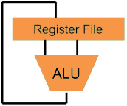
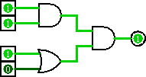
Computer Architecture
Higher-Level Language Program (e.g. C)
temp = v[k];
v[k] = v[k+1];
v[k+1] = temp;
Compiler
lw t0, 0(x2)
lw t1, 4(x2)
sw t1, 0(x2)
sw t0, 4(x2)
Assembly Language Program (e.g. RISCV)
Assembler
0000 1001 1100 0110 1010 1111 0101 1000
1010 1111 0101 1000 0000 1001 1100 0110
1100 0110 1010 1111 0101 1000 0000 1001
0101 1000 0000 1001 1100 0110 1010 1111
Machine Language Program (RISCV)
We are here
Machine Interpretation
Hardware Architecture Description (e.g. block diagrams)
Architecture Implementation
Logic Circuit Description (Circuit Schematic Diagrams)
Notes:
Great Ideas:
Levels of Representation & Interpretation
Technology Trends
Principle of Locality & the Memory Hierarchy
Parallelism
Performance Measurement & Improvement
Dependability via Redundancy

Slide 5
Microarchitecture Components
Microarchitecture has two interacting components
The datapath
The control unit
Datapath operate on words of data
Datapath contains structures such as
Registers
Memories
ALU, Adder, Subtractor, Comparator
Multiplexer
Buses
Control unit
Receives instruction from datapath
It tells datapath how to execute the instructions
It produces control signals for muxes, ALU, registers, Memories

Slide 6
In this class we will study
Muxes, Adder, Subtractor, Comparator
ALU
Sequential logic Circuits – Signal and Waveforms
Registers

Slide 7
Muxes, Adder, Subtractor, Comparator

Slide 8
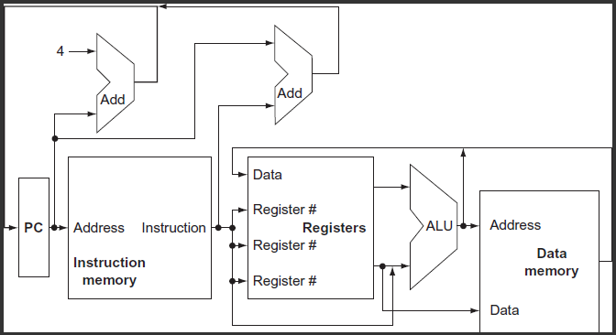
Conceptual RISC-V Datapath
Prof Krste Asanović & Randy H. Katz, Univ of California, Berkeley

Slide 9
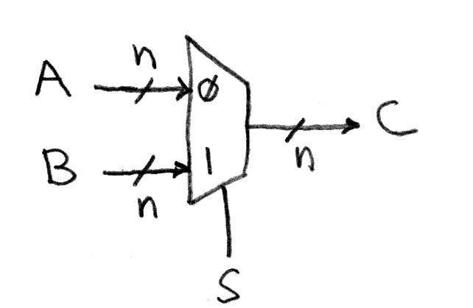
Data Multiplexer(e.g., 2-to-1 x n-bit-wide)
Hardware is hard – permanent – It does what you want it to do
Use Muxes to pick from among inputs
S input selects on one of 2^{S} inputs
“mux”
Represents that this wire has n bits
Prof Krste Asanović & Randy H. Katz, Univ of California, Berkeley
Notes:
Go to Logisim and do design from mux

Slide 10
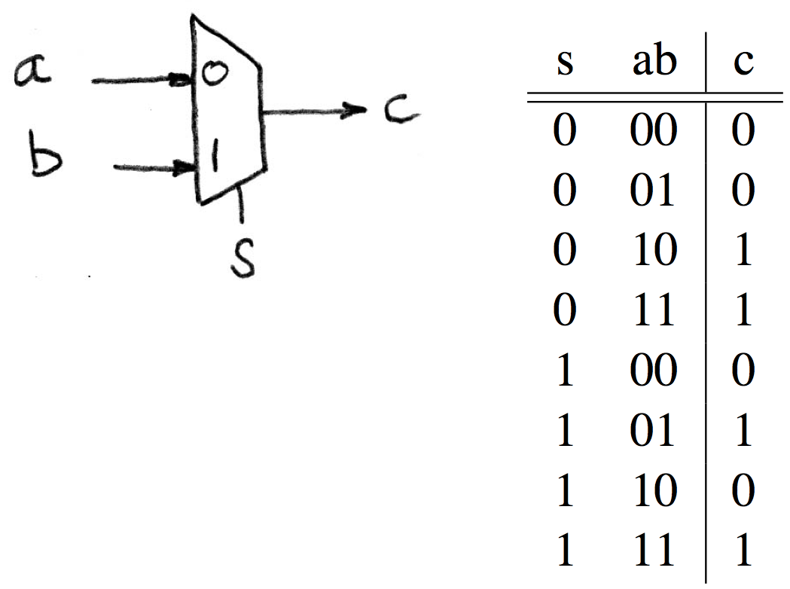
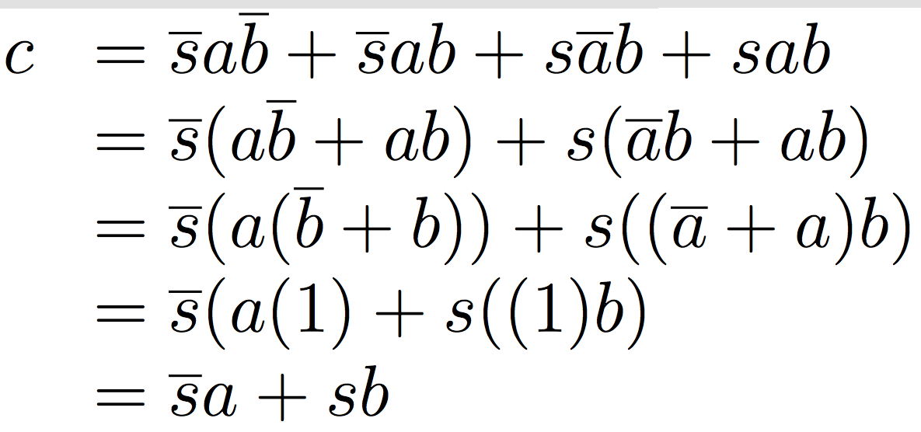
N Instances of 1-bit-Wide Mux
Prof Krste Asanović & Randy H. Katz, Univ of California, Berkeley

Slide 11
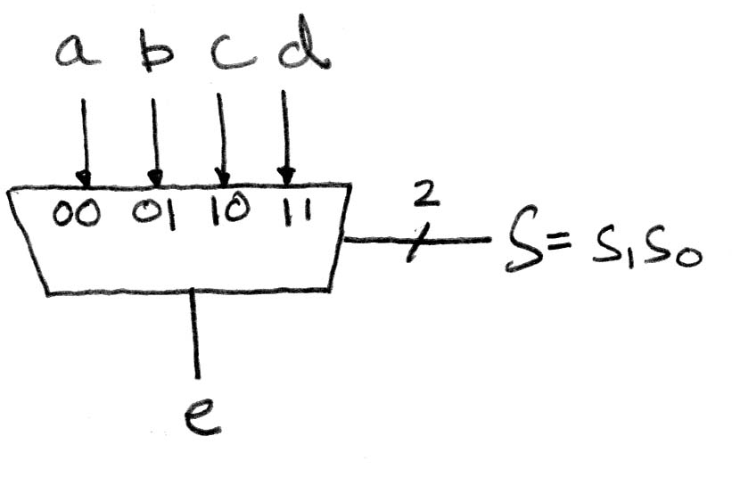
1-bit 4-to-1 Multiplexer
How many rows in Truth Table?
Prof Krste Asanović & Randy H. Katz, Univ of California, Berkeley

Slide 12
1-Bit Adder (self study)
1-Bit Adders

Slide 13
Multibit Adder
Types of carry-propagate adders (CPAs):
Ripple-carry (slow)
Carry-lookahead (fast)
Prefix (faster)
Carry-lookahead and prefix adders are fast for large adders but require more hardware
Symbol
Ref: Harris and Harris Book: Digital Design and Computer Architecture: RISC-V Edition

Slide 14
Subtractor
C_{in} = 1
Ref: Harris and Harris Book: Digital Design and Computer Architecture: RISC-V Edition
Notes:
To compute Y = A − B, first create the two’s complement of B: Invert the bits of B to obtain B and add 1 to get −B=B+1. Add this quantity to A to get Y=A+B+1=A−B. This sum can be performed with a single CPA by adding A + B with Cin = 1

Slide 15
Comparator
A comparator determines whether two binary numbers are equal or if one is greater or less than the other.
Two types
Equality Comparator
Magnitude comparator (less than)
Ref: Harris and Harris Book: Digital Design and Computer Architecture: RISC-V Edition

Slide 16
Comparator: Equality
Ref: Harris and Harris Book: Digital Design and Computer Architecture: RISC-V Edition

Slide 17
Arithmetic and Logic Unit (ALU)

Slide 18
Conceptual RISC-V Datapath - ALU
Prof Krste Asanović & Randy H. Katz, Univ of California, Berkeley

Slide 19
ALU: Arithmetic Logic Unit
Most processors contain a special logic block called “Arithmetic and Logic Unit” (ALU)
Let’s consider a very simple ALU
ALU should perform:
Addition
Subtraction
AND
OR
Ref: Harris and Harris Book: Digital Design and Computer Architecture: RISC-V Edition

Slide 20
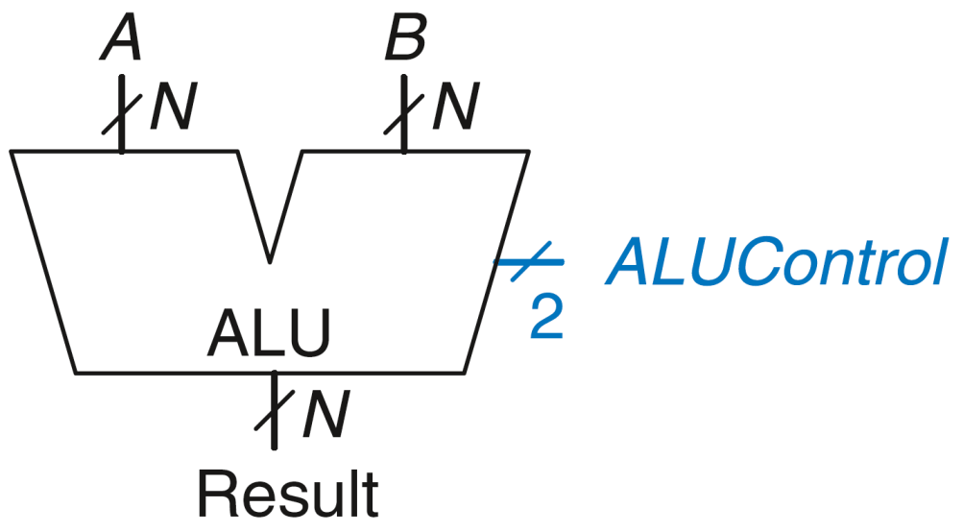
ALU: Arithmetic Logic Unit
ALUControl_{1:0} | Function
00 | Add
01 | Subtract
10 | AND
11 | OR
Example: Perform A + B
ALUControl = 00
Result = A + B
Ref: Harris and Harris Book: Digital Design and Computer Architecture: RISC-V Edition

Slide 21
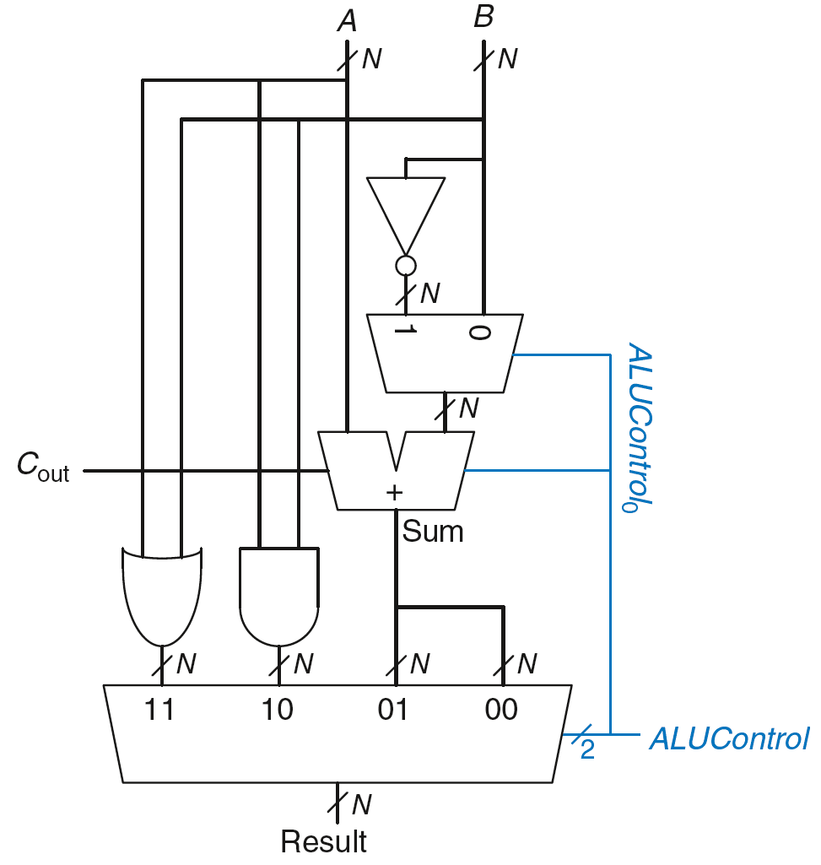
ALU: Arithmetic Logic Unit
ALU: Arithmetic Logic Unit
ALUControl_{1:0} | Function
00 | Add
01 | Subtract
10 | AND
11 | OR
Example: Perform A OR B
Ref: Harris and Harris Book: Digital Design and Computer Architecture: RISC-V Edition

Slide 22
ALU: Arithmetic Logic Unit
ALU: Arithmetic Logic Unit
ALUControl_{1:0} | Function
00 | Add
01 | Subtract
10 | AND
11 | OR
Example: Perform A OR B
ALUControl_{1:0} = 11
Mux selects output of OR gate as Result, so
Result = A OR B
Ref: Harris and Harris Book: Digital Design and Computer Architecture: RISC-V Edition

Slide 23
ALU: Arithmetic Logic Unit
ALU: Arithmetic Logic Unit
ALUControl_{1:0} | Function
00 | Add
01 | Subtract
10 | AND
11 | OR
Example: Perform A + B
ALUControl_{1:0} = 00
ALUControl₀ = 0, so:
C_{in} to adder = 0
2nd input to adder is B
Mux selects Sum as Result, so
Result = A + B

Slide 24
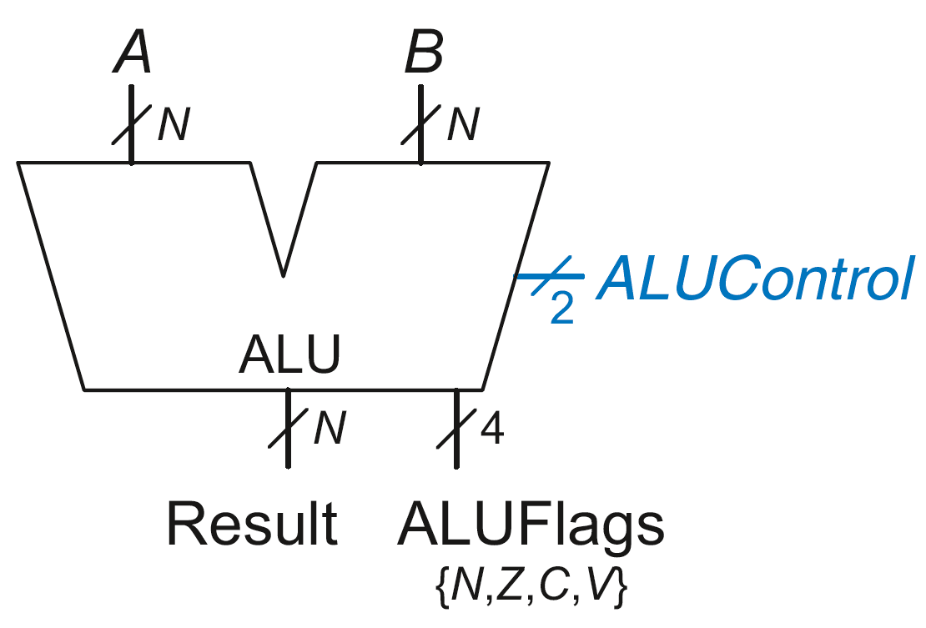
ALU with Status Flag
ALU with Status Flags
Flag | Description
N | Result is Negative
Z | Result is Zero
C | Adder produces Carry out
V | Adder oVerflowed
Some ALUs are designed with extra outputs called flags
Ref: Harris and Harris Book: Digital Design and Computer Architecture: RISC-V Edition

Slide 25
Sequential Logic Components - Basics

Slide 26
Type of Circuits
Digital Systems consist of two basic types of circuits:
Combinational Logic (CL)
Output is a function of the inputs only, not the history of its execution
e.g. circuits to add A, B (ALUs)
Sequential Logic (SL)
Circuits that “remember” or store information
a.k.a. “State Elements”
e.g. memory and registers (Registers)

Slide 27
Accumulator Example
An example of why we would need sequential logic
SUM
X_{i}
S
Want: S=0;
for X₁,X₂,X₃ over time...
S = S + X_{i}
Assume:
Each X value is applied in succession, one per cycle
The sum since time 1 (cycle) is present on S
Prof Krste Asanović & Randy H. Katz, Univ of California, Berkeley

Slide 28
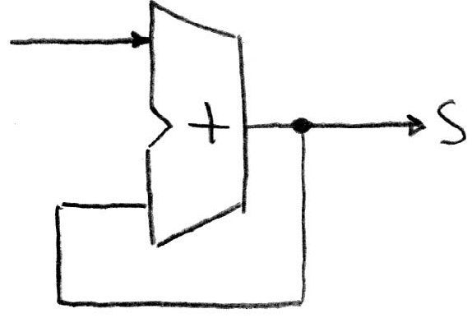
First Try: Does this work?
X
Feedback
No!
How to control the next iteration of the ‘for’ loop?
How do we say: S = 0?
Prof Krste Asanović & Randy H. Katz, Univ of California, Berkeley

Slide 29
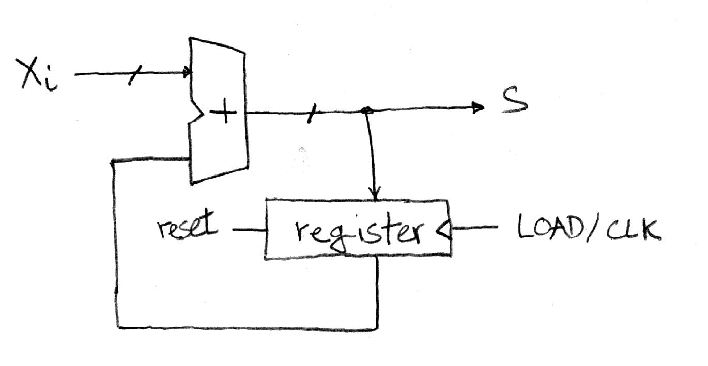
Second Try: How About This?
A Register is the state element that is used here to hold up the transfer of data to the adder
Prof Krste Asanović & Randy H. Katz, Univ of California, Berkeley

Slide 30
Uses for State Elements
Place to store values for some amount of time:
Register files (like in RISC-V)
Memory (caches and main memory)
Help control flow of information between combinational logic blocks
State elements are used to hold up the movement of information at the inputs to combinational logic blocks and allow for orderly passage
Prof Krste Asanović & Randy H. Katz, Univ of California, Berkeley

Slide 31
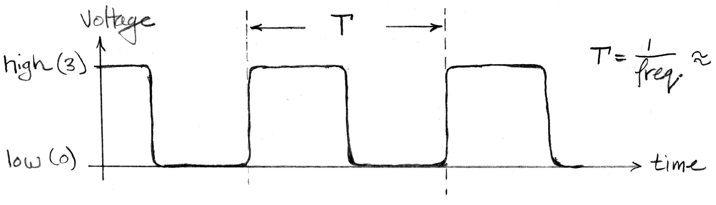
Signals and Waveforms: Clocks
Clock period (CPU cycle time)
Rising Edge
Falling Edge
Signals transmitted over wires continuously
Transmission is effectively instantaneous
Implies that any wire only contains one value at any given time
Prof Krste Asanović & Randy H. Katz, Univ of California, Berkeley

Slide 32
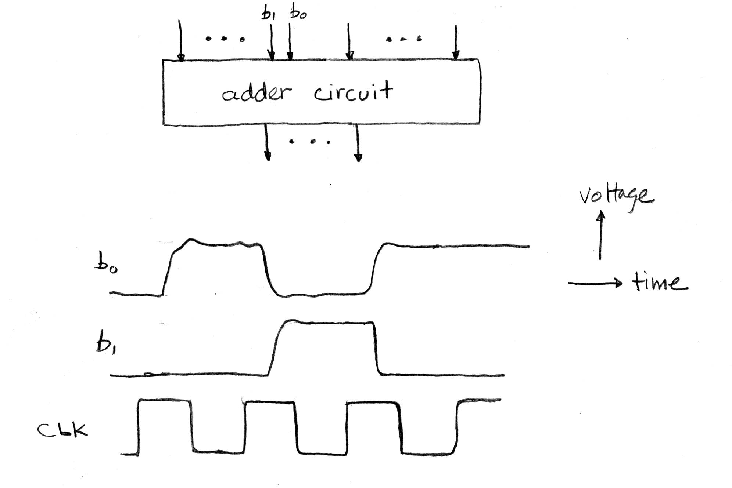
Signals and Waveforms
Stack signals on top of each other
All signals change after clock “triggers”
Prof Krste Asanović & Randy H. Katz, Univ of California, Berkeley

Slide 33
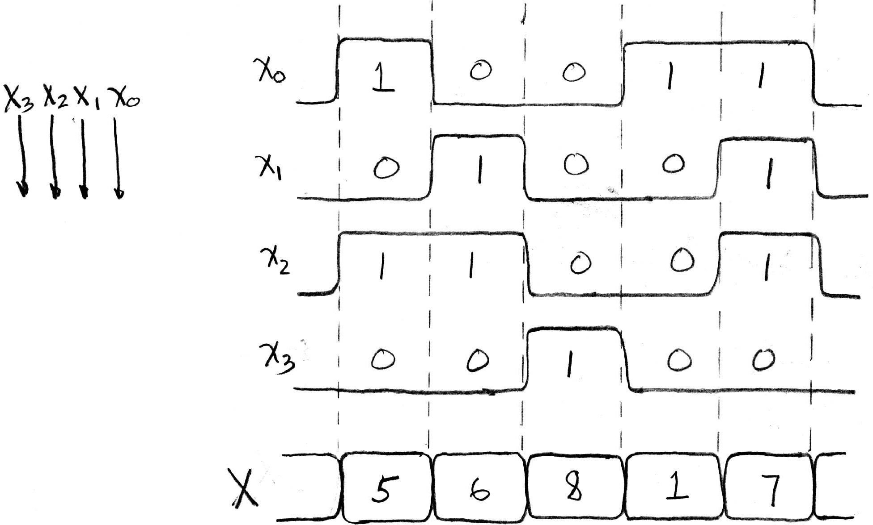
Signals and Waveforms: Grouping
X
A group of wires when interpreted as a bit field is called a bus
Time
Prof Krste Asanović & Randy H. Katz, Univ of California, Berkeley

Slide 34
Dealing with Waveform Diagrams
When does a signal update?
A state element updates based on CLK triggers
A combinational element updates ANY time ANY of its inputs changes

Slide 35
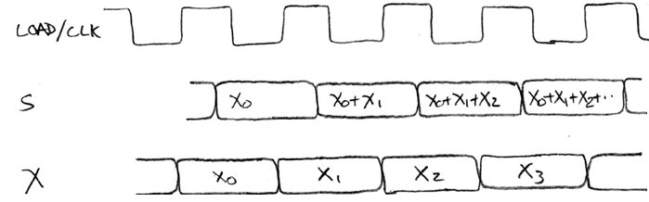
Second Try: How About This?
Delay through Adder
Rough timing …
Time
Prof Krste Asanović & Randy H. Katz, Univ of California, Berkeley

Slide 36
Registers - Basics

Slide 37
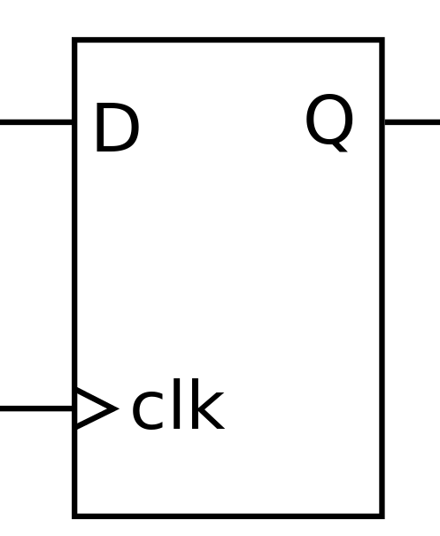
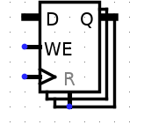
Registers
Small memory storage locations
Data input (can be various bit widths)
Data output (can be various bit widths)
Write Enable (can it be written to)
Clock input (inputs active only on a clock “tick”)
Reset (sets value to zero)
Prof Krste Asanović & Randy H. Katz, Univ of California, Berkeley

Slide 38
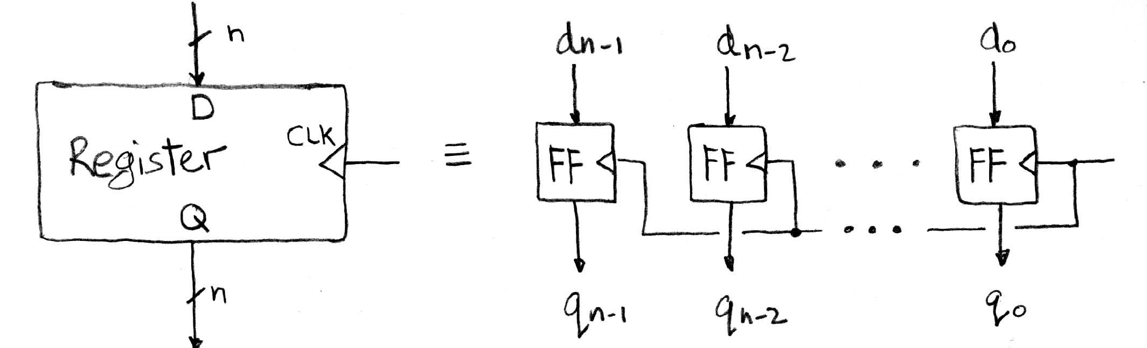
Register Internals (revision)
n number of Flip-Flops
Output flips and flops between 0 and 1
Specifically this is a “D-type Flip-Flop”
D is “data input”, Q is “data output”
In reality, has 2 outputs (Q and Q), but we only care about 1
Prof Krste Asanović & Randy H. Katz, Univ of California, Berkeley
Notes:
Can see Wikipedia page for gate internals and other types of flip-flops.

Slide 39
Lecture Summary
Datapath consists of many combinational logic components including Multiplexers, Adders, Subtractors, Comparators etc
We have studied sequential logic component basics

